Slide 1
WEKA Experimenter and KnowledgeFlow

Slide 2
What is different from Explorer?
Experimenter is used for ‘batches’ of experiments
Can only be used for Classification and Regression problems
Results are generated in a different way
Explorer:
% correct = (sum of correctly classified instances for all test folds)/(Total No. of instances in dataset)
Experimenter:
% correct = Average of correctly predicted over all folds

Slide 3
Experimenter - Overview
Compare the performance of different learning schemes easily
Allows better analysis than Explorer
Results: write-to-file or database
Evaluation: cross-validation, learning curve, or hold-out
Ability to iterate over different parameter settings
Statistical significance tests “for free”!

Slide 4
Experimenter - Overview
The interface essentially has three ‘panes’:
Setup: Configure experiments
Run: Generate results files
Analyze: Analyze the results of the experiments

Slide 5
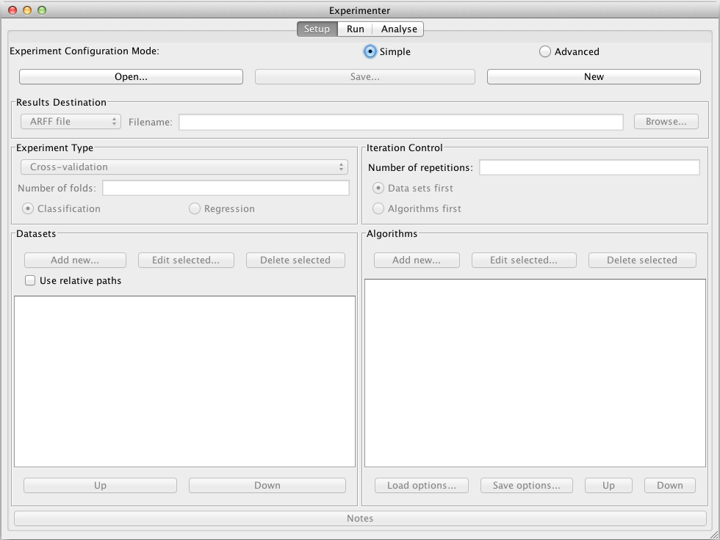

Slide 6
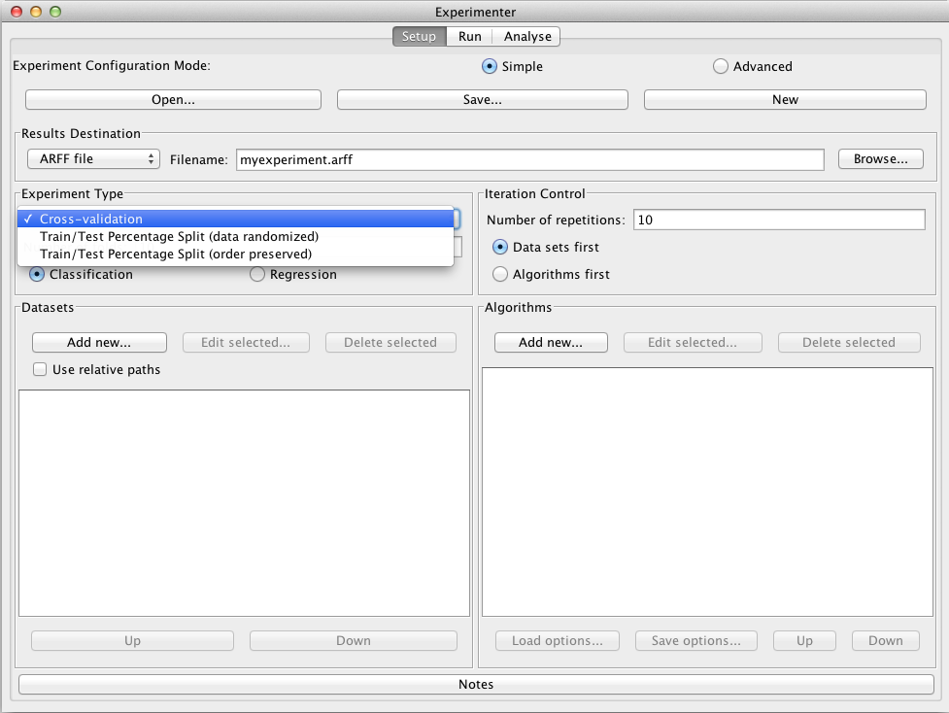

Slide 7
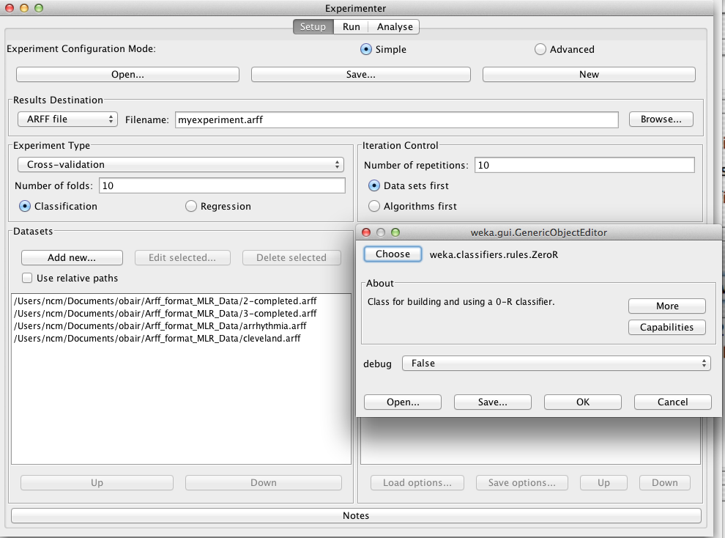

Slide 8
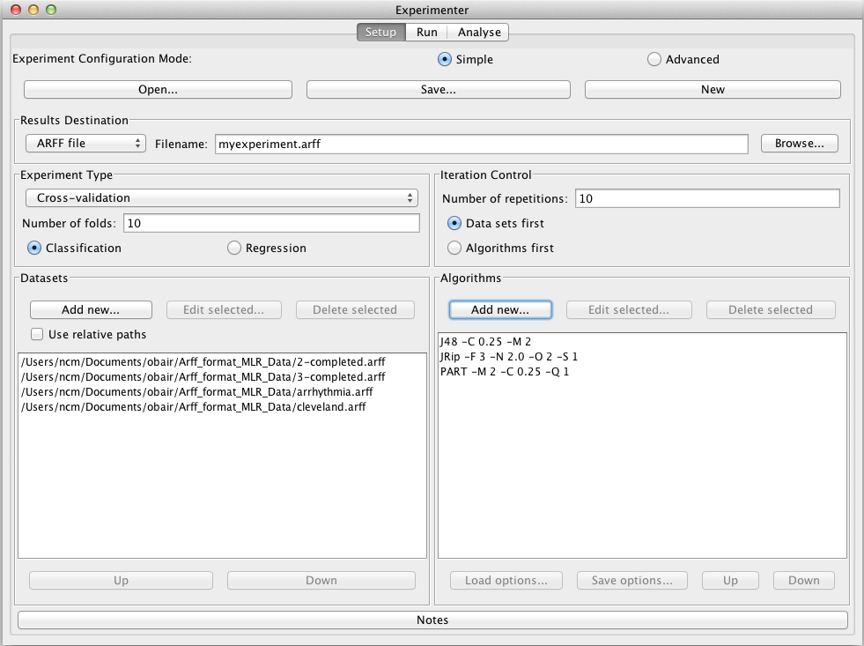

Slide 9
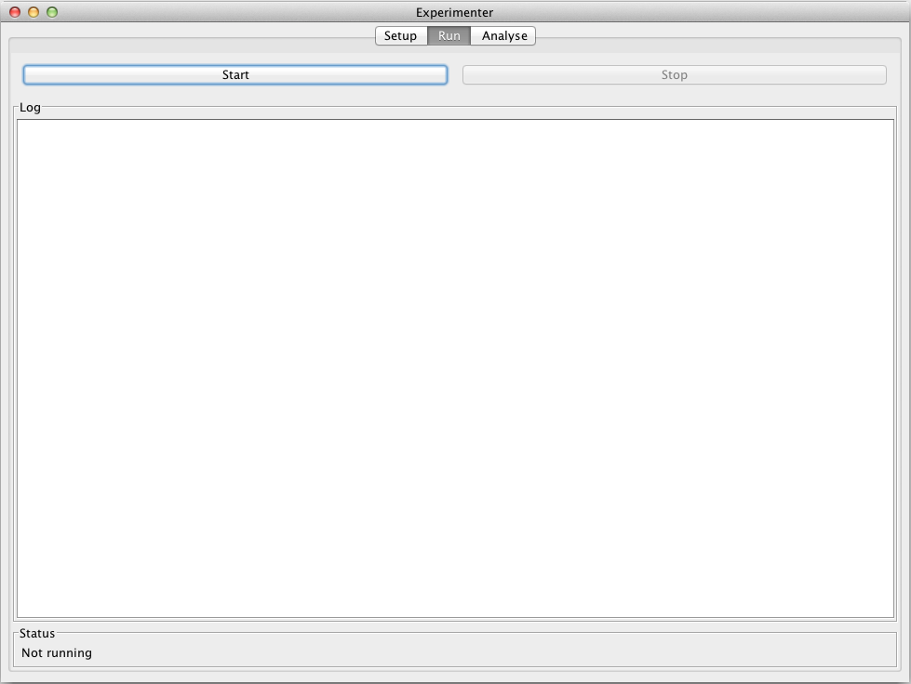

Slide 10
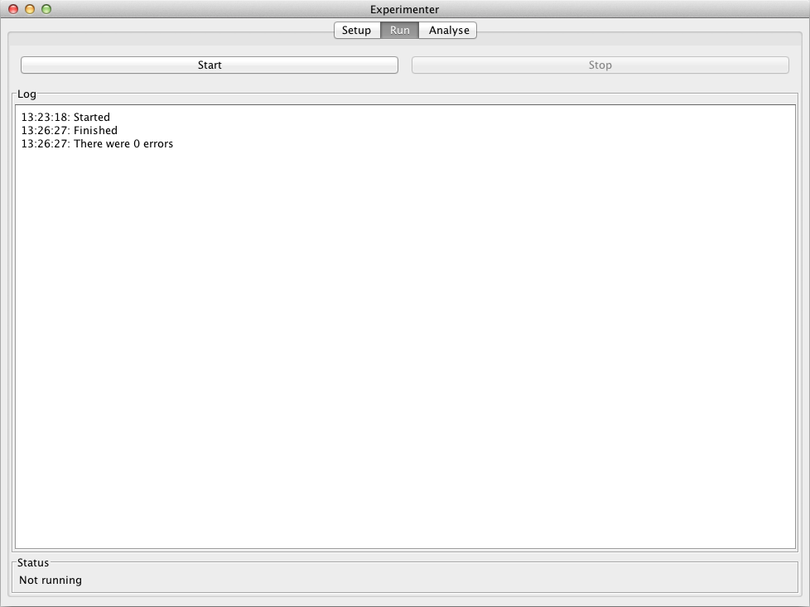

Slide 11
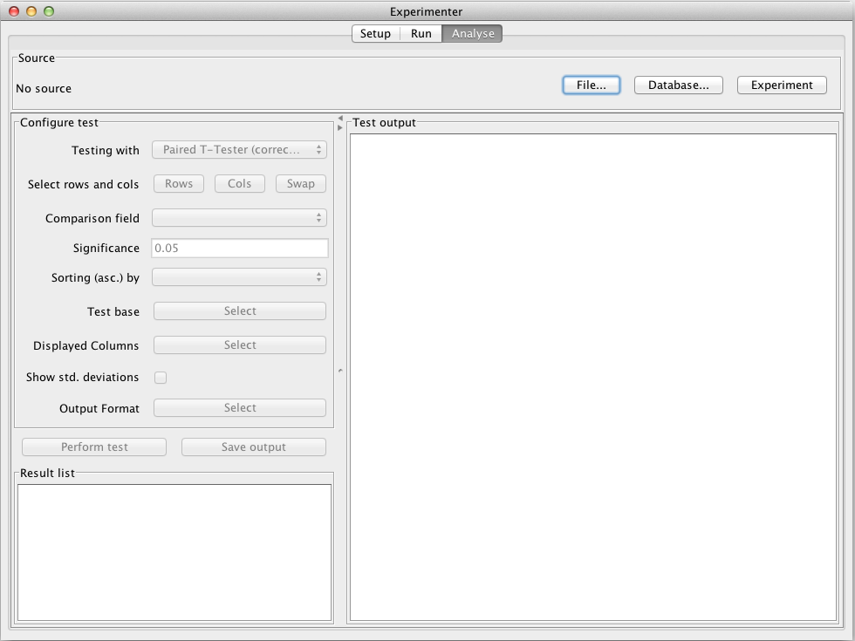

Slide 12
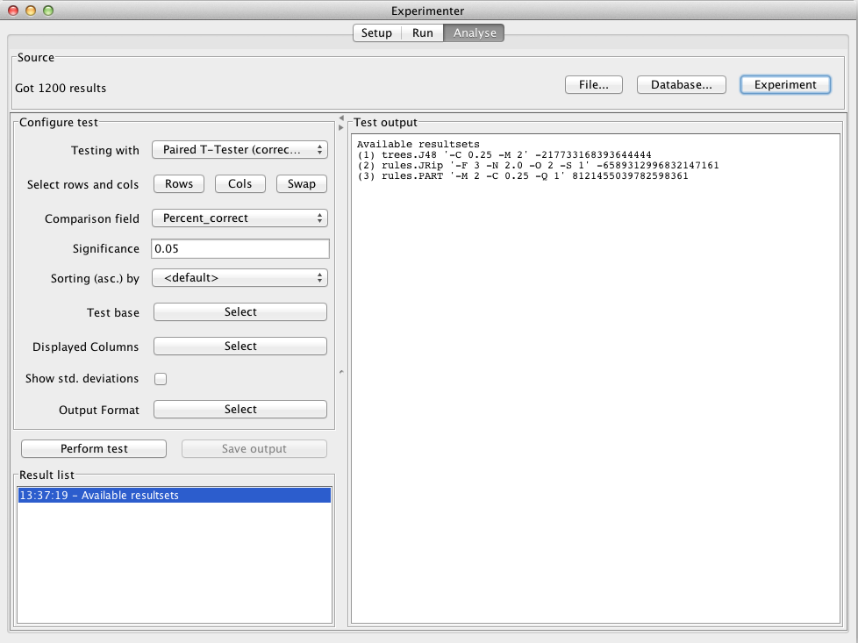
Always use ‘corrected’ T-Tester!
Use this to decide how you compare results

Slide 13
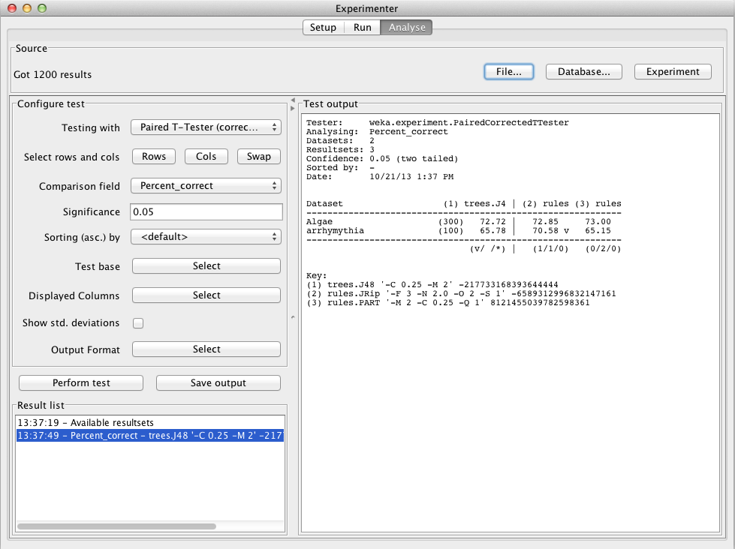

Slide 14
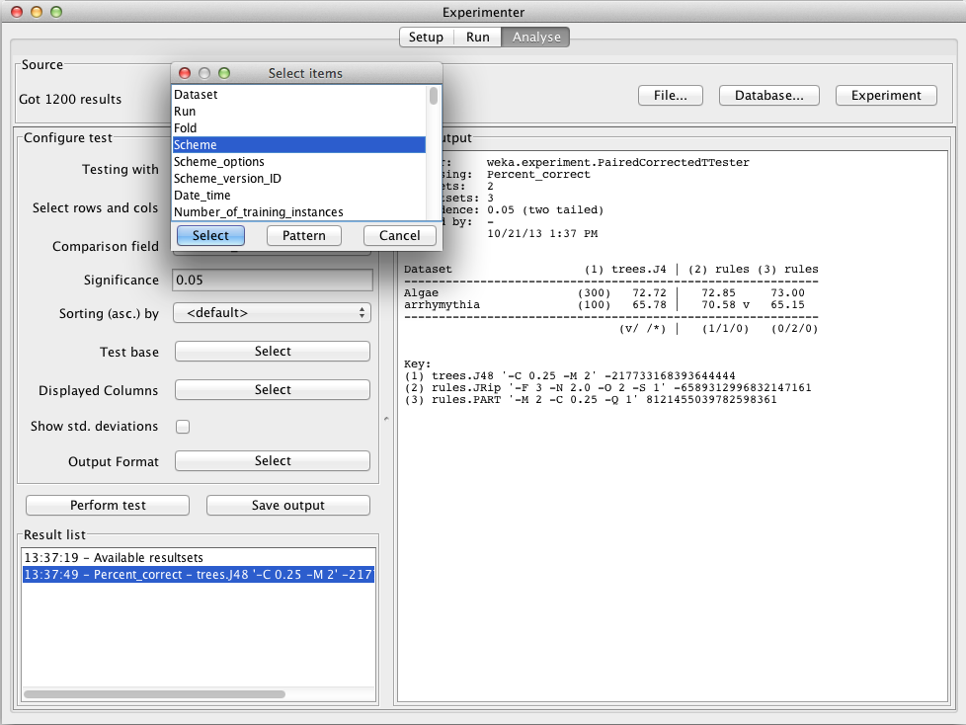

Slide 15
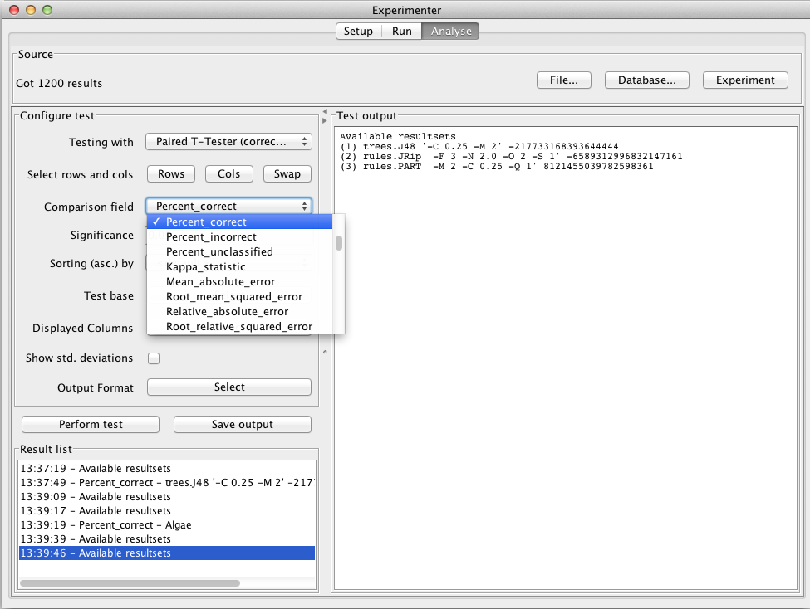
Lots of different ways to compare results!

Slide 16
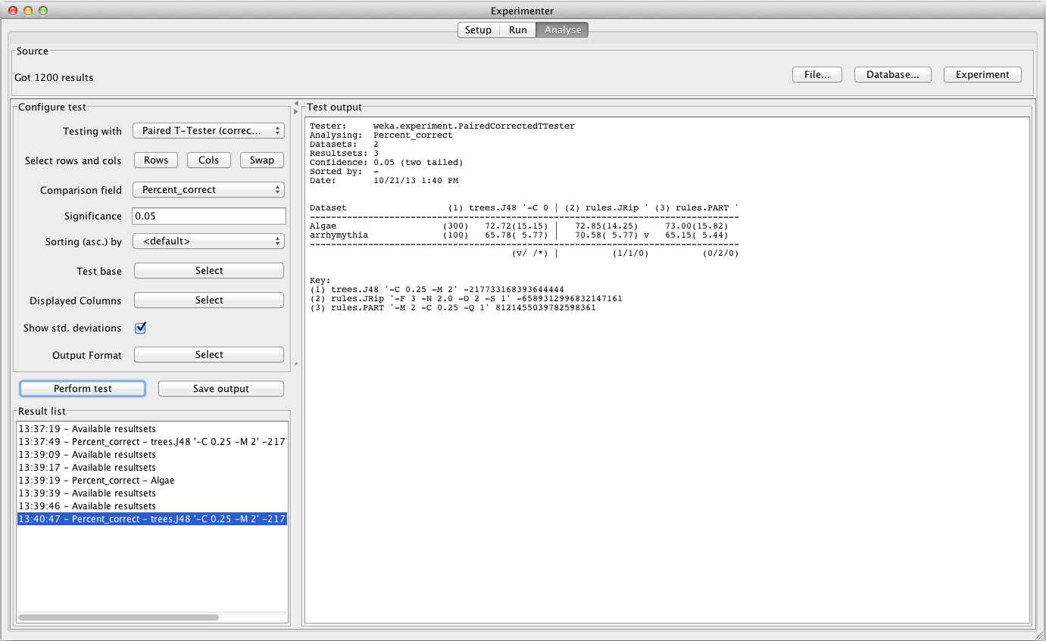

Slide 17
Knowledge Flow Interface
“Visual: drag-and-drop” user interface for WEKA - intuitive
Java-Beans-based
Can do everything that Explorer does (plus a bit more), but not as comprehensively as Experimenter
Data sources, classifiers, etc. are beans and can be connected graphically
Data “flows” through modules: e.g.,
“data source” ->“filter” ->“classifier”-> “evaluator”
KF layouts can be saved and re-used later

Slide 18
Knowledge Flow: An Example
What we want to do:
Take a dataset
Do some attribute selection
Perform some classification on the reduced data using 10 fold CV
Examine the subsets selected for each CV fold
Visualize the results in text format and ROC

Slide 19
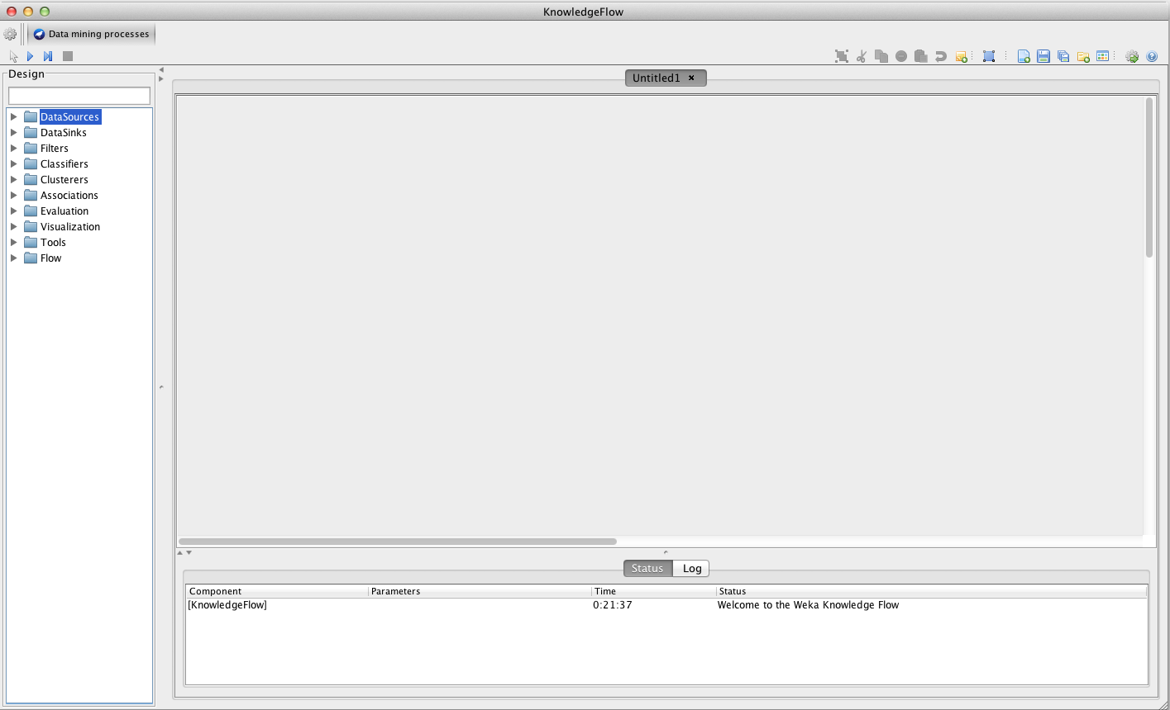
Getting Started

Slide 20
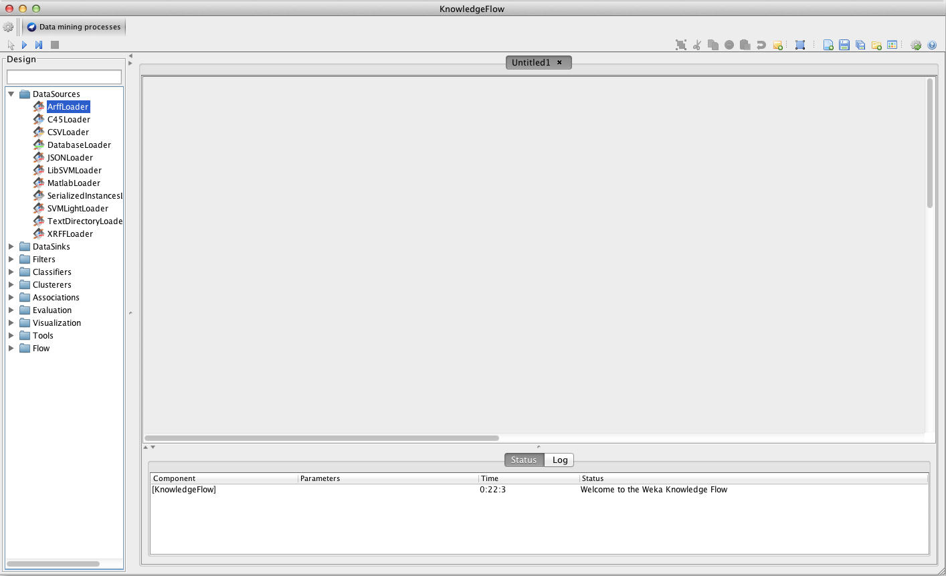

Slide 21
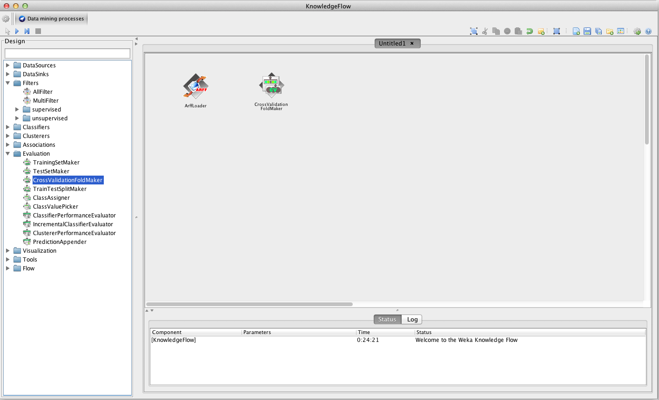
A few ‘hidden’ steps…

Slide 22
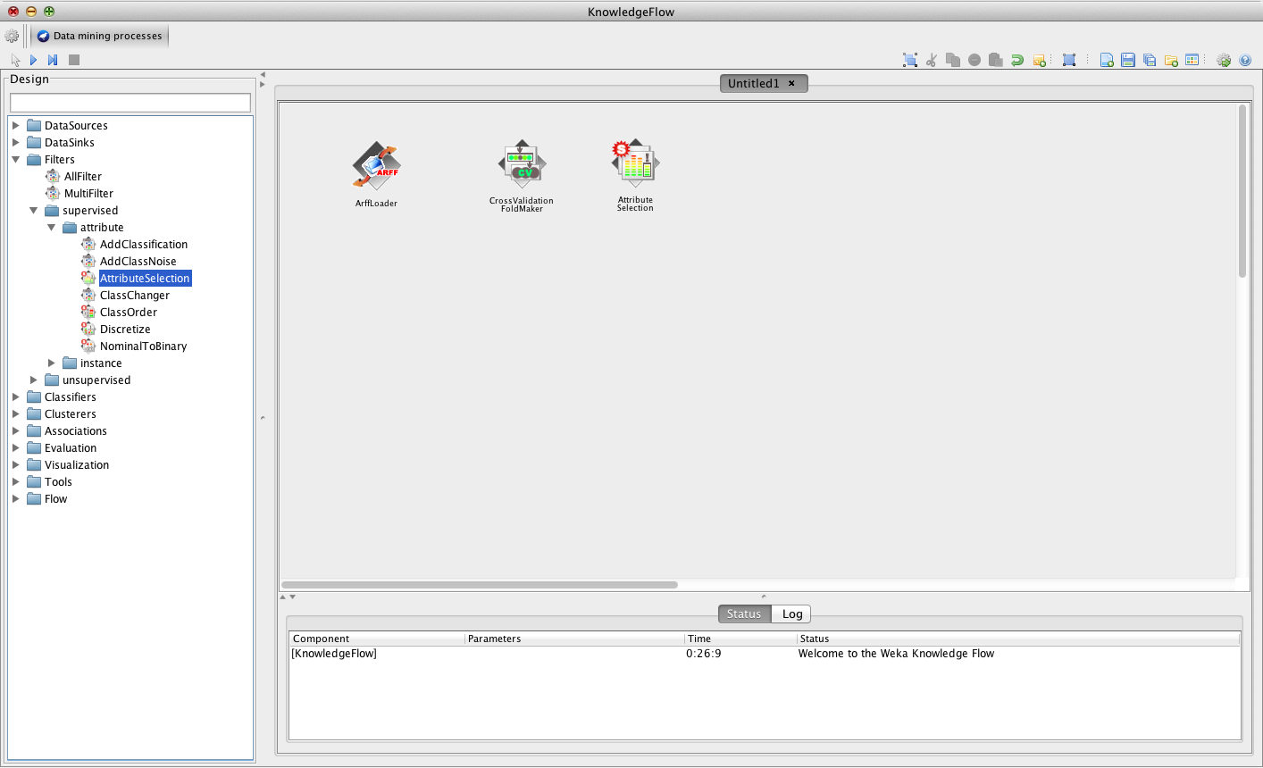

Slide 23
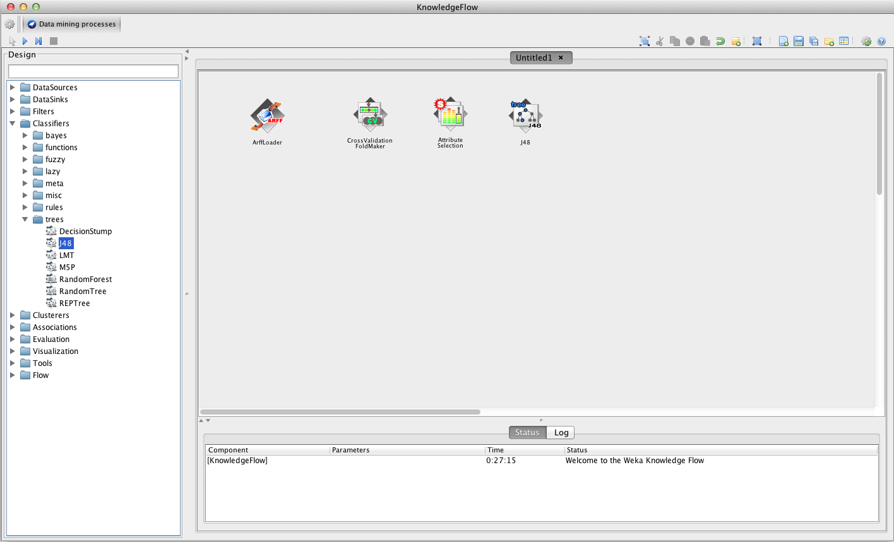
Add the Classifier learner

Slide 24
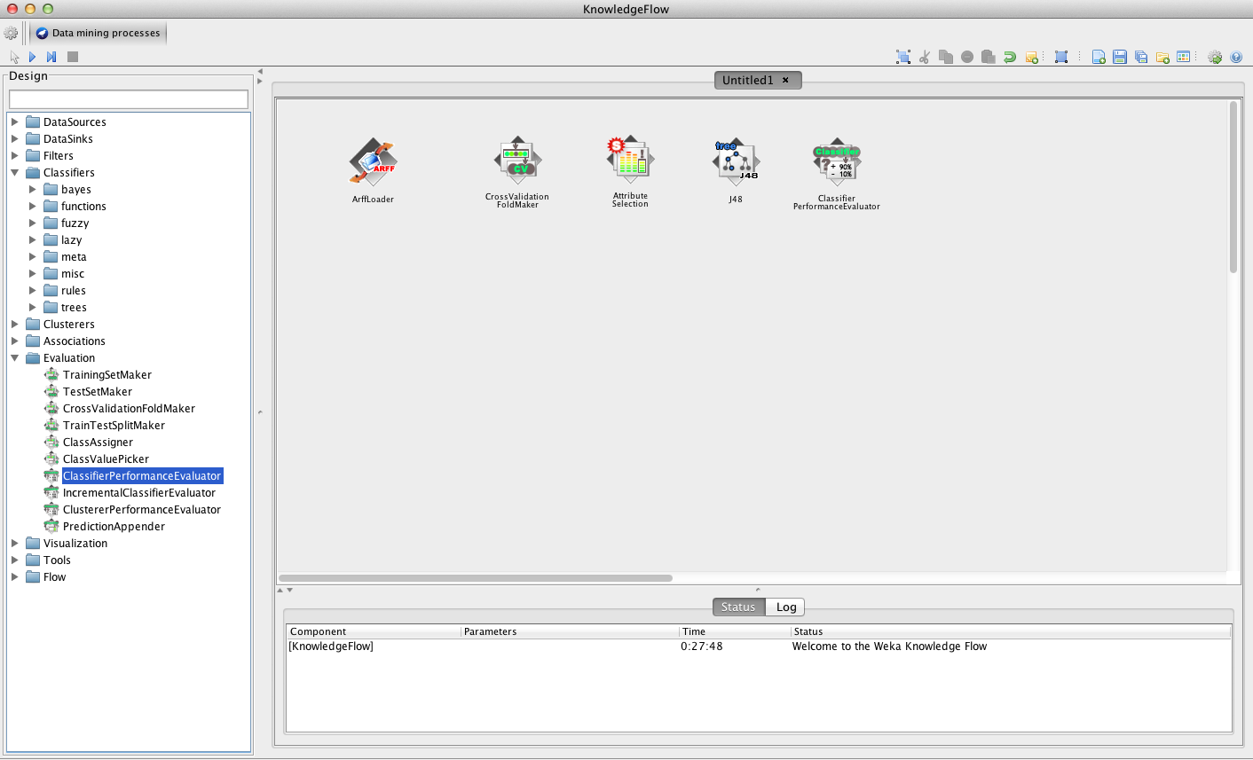
…and the performance evaluator

Slide 25
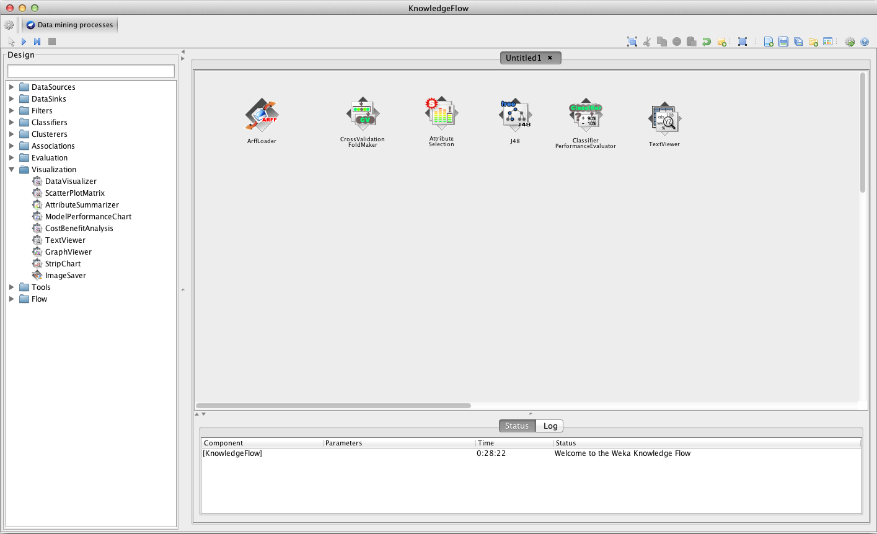
TextViewers can be used for visualization of results as well as examining the processes – more later…

Slide 26
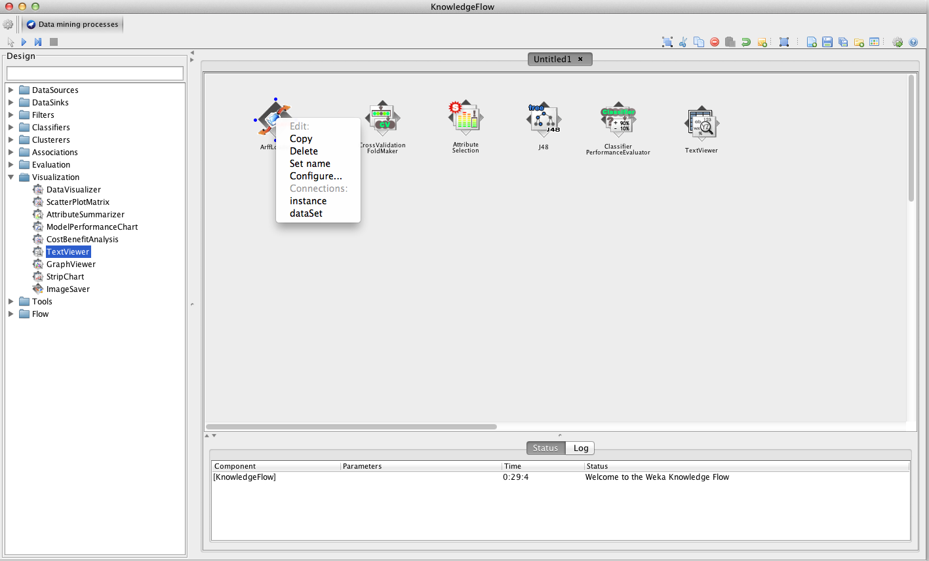
‘Right-clicking’ on each ‘block’ allows you to configure it as well as ‘wire-up’ to others…

Slide 27
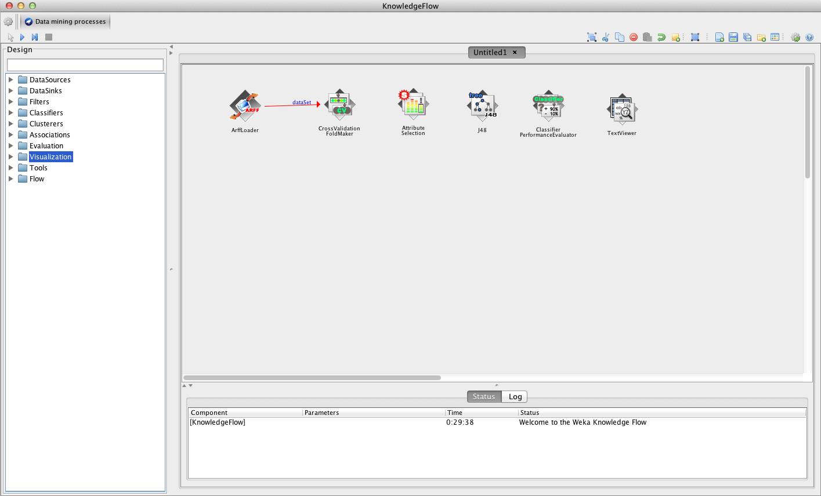
Connect: data set to CrossValidationFoldMaker

Slide 28
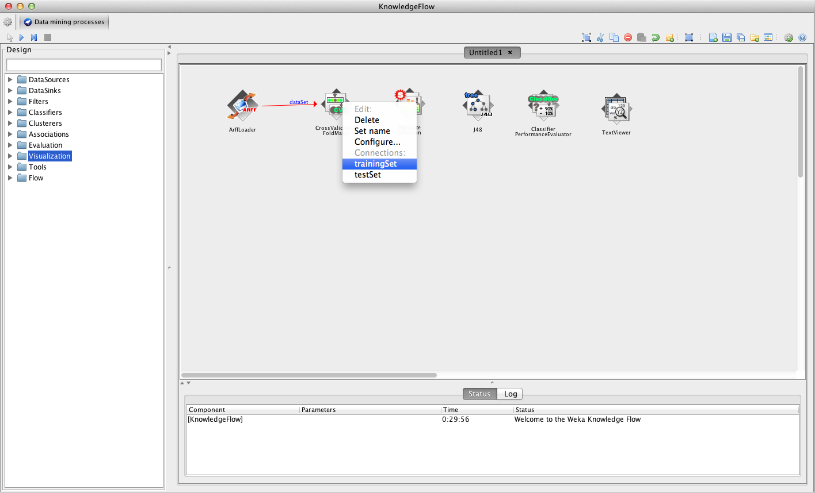
Continue to ‘wire-up’ each ‘block’…

Slide 29
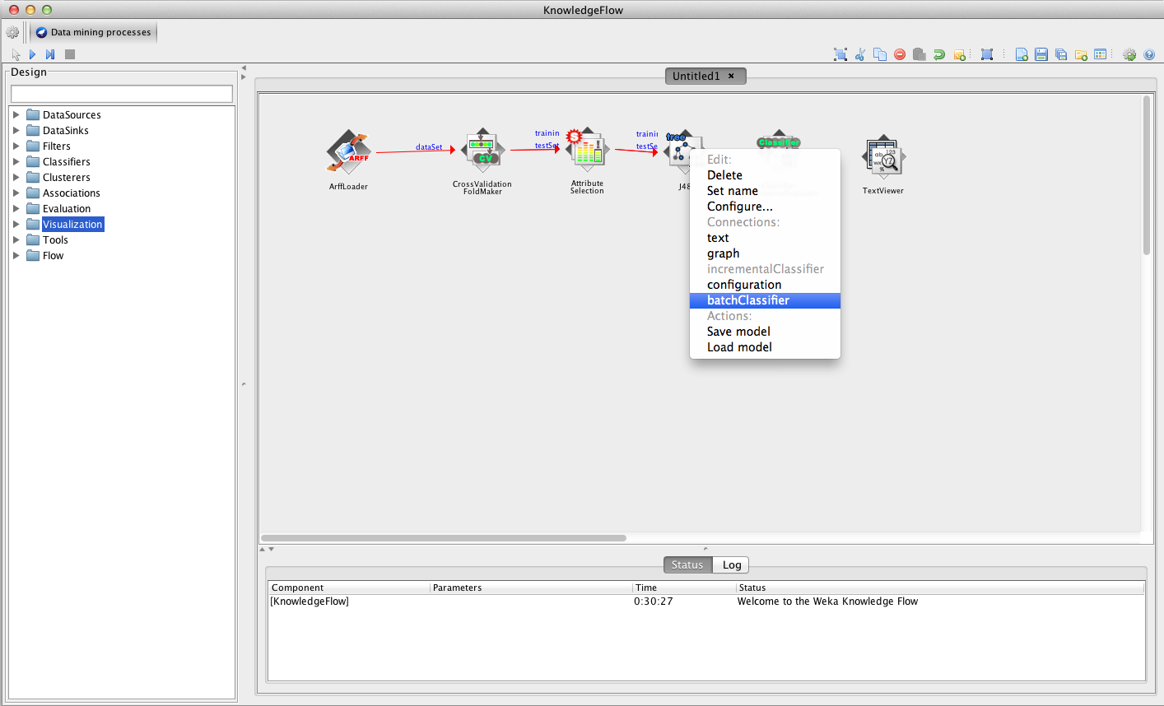
…and so on

Slide 30
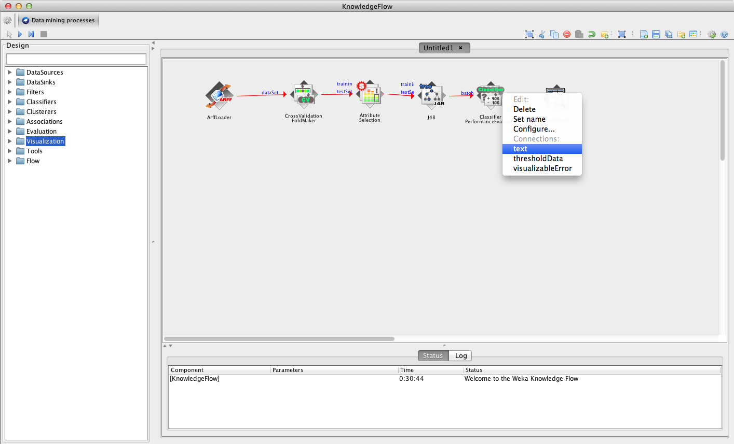
To see the results output: ‘dump’ the text to TextViewer…

Slide 31
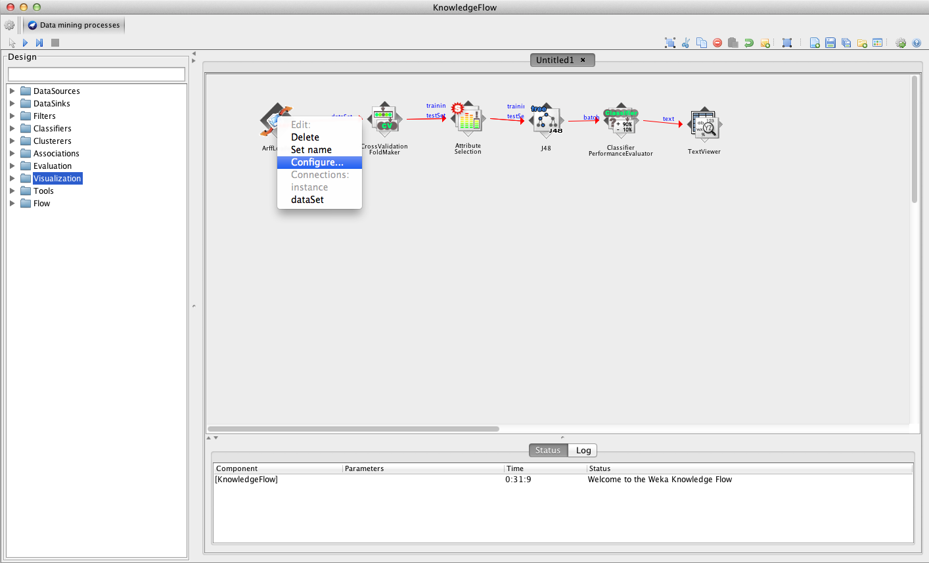
When you have finished ‘wiring-up’, it’s time to configure each of the components/blocks…

Slide 32
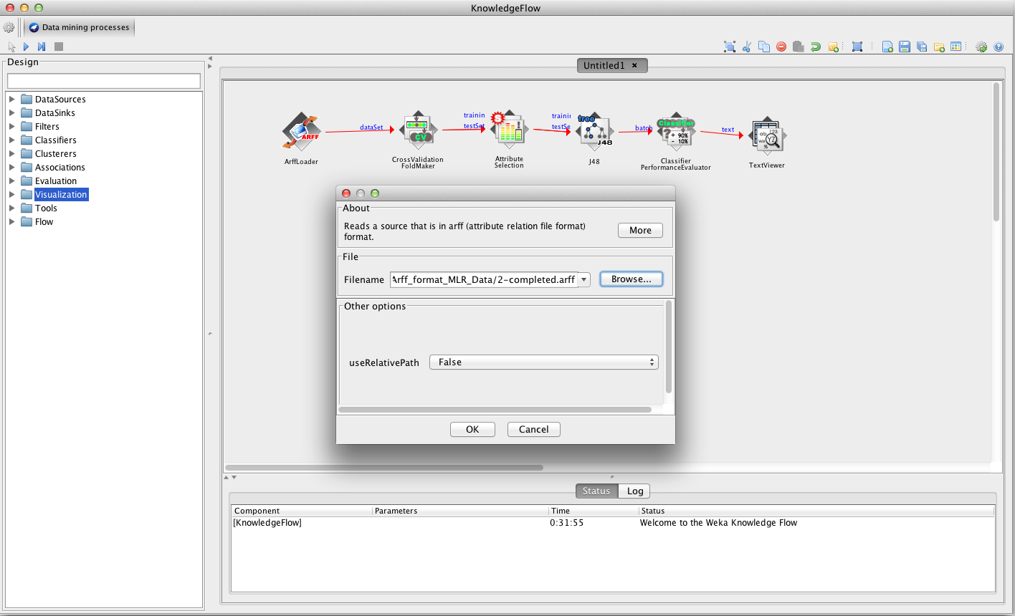
Set the path/filename(s) of the datasets you would like to load…

Slide 33
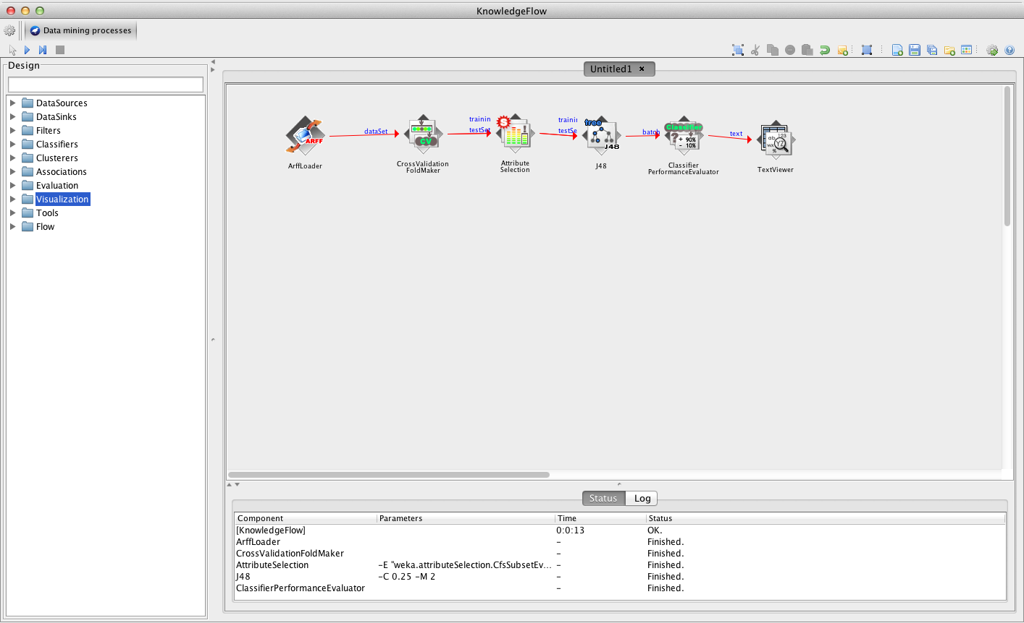
Once all is configured, you are ready to start…

Slide 34
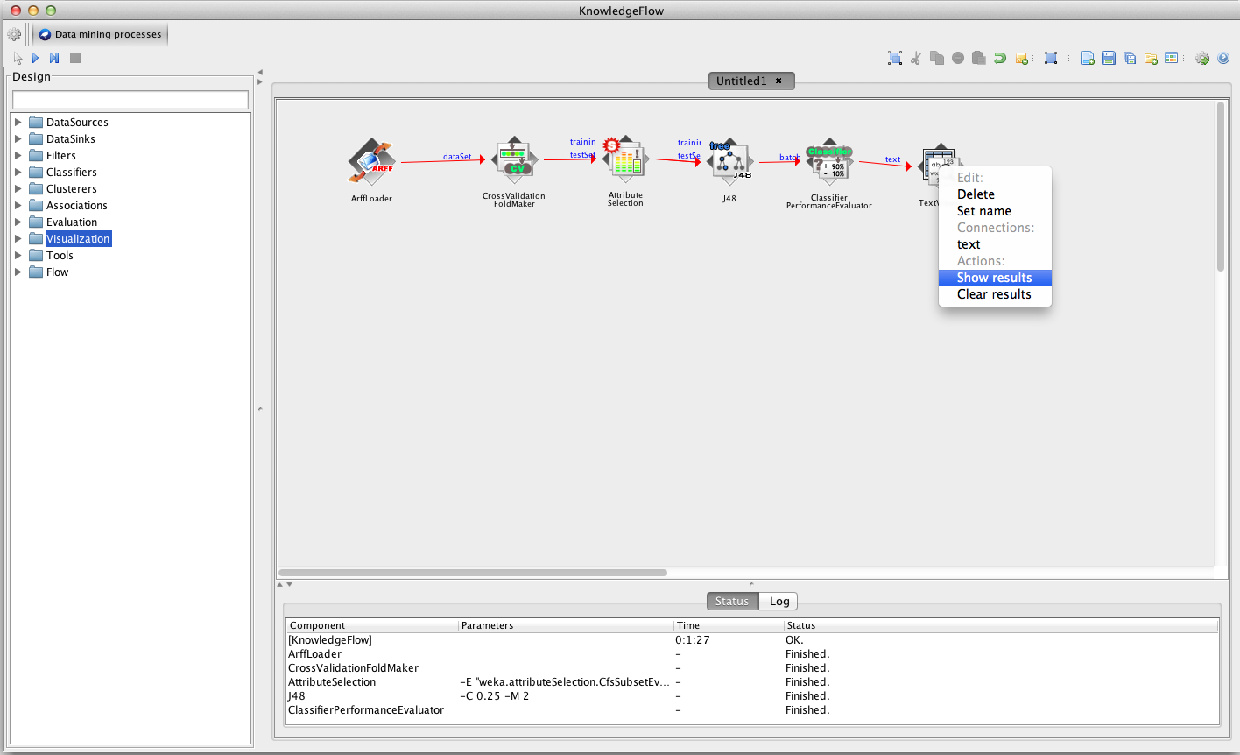
Once all experiments have finished, we can visualize the results…

Slide 35
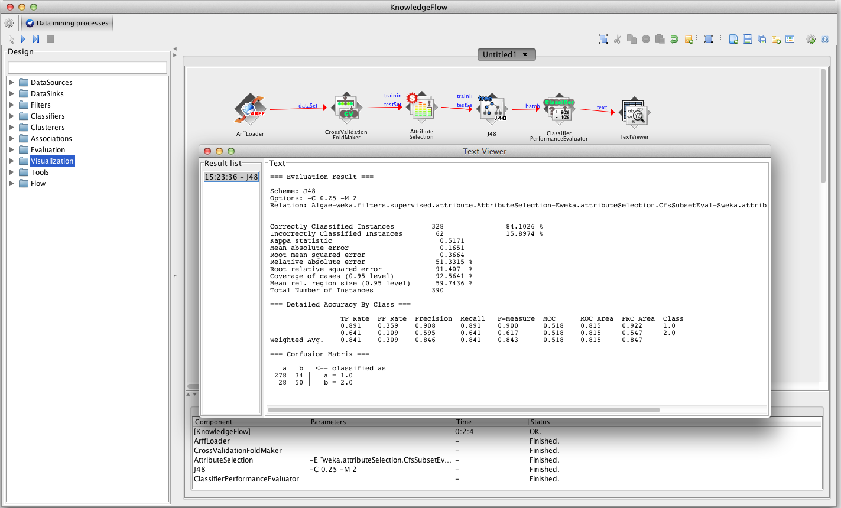
Output is similar to that of console window of Explorer

Slide 36
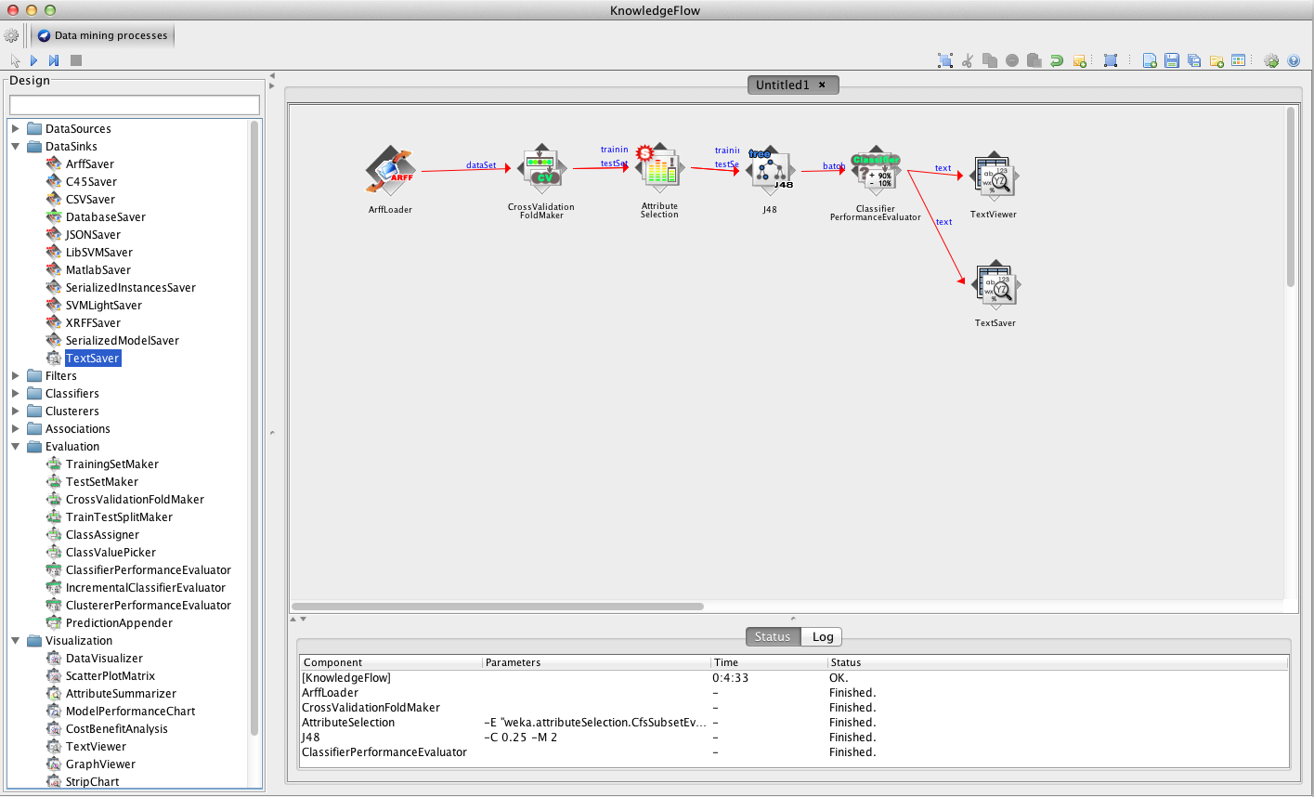
But there are also ways save these results if we want to keep them for later…

Slide 37
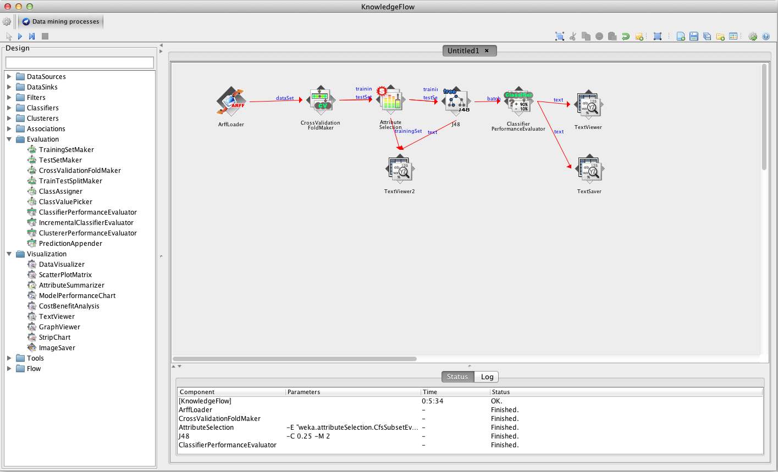
TextViewer components are also useful for ‘looking-inside’ processes…

Slide 38
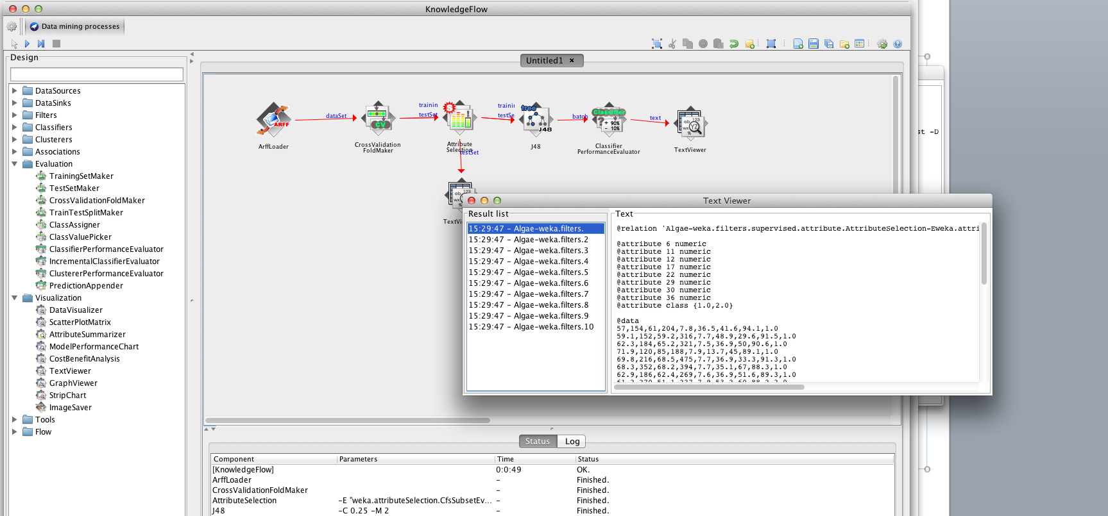
For example: attribute selection….

Slide 39
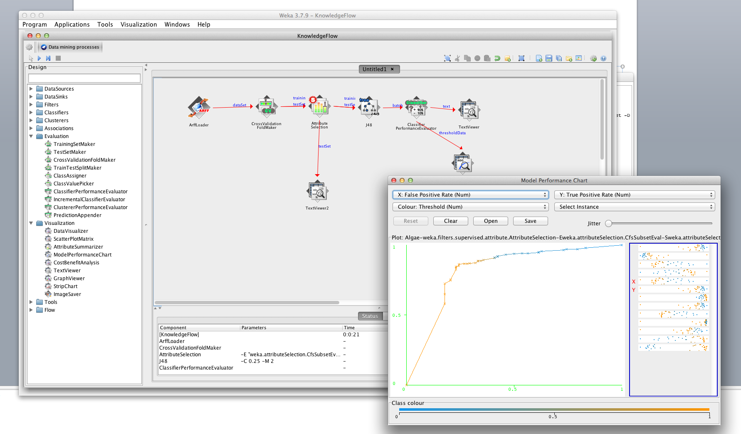
It is also possible to visualize data in a similar way to Explorer…e.g. ROC/threshold curves

Slide 40

How to include Weka in your Java application
This book shows you exactly how to include Weka's machinery in your Java application. This book starts by importing and preparing the data, and then moves to more serious topics, such as classification, regression, clustering, and evaluation.

Slide 41
Example: clustering

Slide 42
public class Classifier {
public static void main(String args[]) throws Exception{
Instances dataset = LoadData.loadDataset("dataset/titanic.arff");
dataset.setClassIndex(dataset.numAttributes()-1);
// decision trees
String[] options = new String[1];
options[0] = "-U";
J48 tree = new J48();
tree.setOptions(options);
tree.buildClassifier(dataset);
System.out.println(tree);
// support vector machines
SMO svm = new SMO();
svm.buildClassifier(dataset);
System.out.println(svm);
//incremental Naive Bayes classifier
ArffLoader loader = new ArffLoader();
loader.setFile(new File("dataset/titanic.arff"));
Instances dataStructure = loader.getStructure();
dataStructure.setClassIndex(dataStructure.numAttributes() - 1);
NaiveBayesUpdateable nb = new NaiveBayesUpdateable();
nb.buildClassifier(dataStructure);
Instance current;
while ((current = loader.getNextInstance(dataStructure)) != null)
nb.updateClassifier(current);
System.out.println(nb);
}
}

Slide 43
Example: classifier
* Build and use a classifier.
*
* @author http://bostjankaluza.net
*/
import java.io.File;
import weka.classifiers.bayes.NaiveBayesUpdateable;
import weka.classifiers.functions.SMO;
import weka.classifiers.trees.J48;
import weka.core.Instance;
import weka.core.Instances;
import weka.core.converters.ArffLoader;

Slide 44
public class Classifier {
public static void main(String args[]) throws Exception{
Instances dataset = LoadData.loadDataset("dataset/titanic.arff");
dataset.setClassIndex(dataset.numAttributes()-1);
// decision trees
String[] options = new String[1];
options[0] = "-U";
J48 tree = new J48();
tree.setOptions(options);
tree.buildClassifier(dataset);
System.out.println(tree);
// support vector machines
SMO svm = new SMO();
svm.buildClassifier(dataset);
System.out.println(svm);
//incremental Naive Bayes classifier
ArffLoader loader = new ArffLoader();
loader.setFile(new File("dataset/titanic.arff"));
Instances dataStructure = loader.getStructure();
dataStructure.setClassIndex(dataStructure.numAttributes() - 1);
NaiveBayesUpdateable nb = new NaiveBayesUpdateable();
nb.buildClassifier(dataStructure);
Instance current;
while ((current = loader.getNextInstance(dataStructure)) != null)
nb.updateClassifier(current);
System.out.println(nb);
}
}

